Slide 1






[FABRIC/KNIT12]
April 14-17, 2026
NSF Program: Office of Advanced Cyberinfrastructure (OAC)
Program Area: Cybertraining, OAC Core
Award No.
2417823, 2403360
Accelerating Fault and Attack Detection in Cyber-Physical Systems Using SmartNICs and DPDK
Samia Choueiri
Ph.D. Student
University of South Carolina
choueiri@email.sc.edu
Sergio Elizalde
Ph.D. Student
University of South Carolina
elizalds@email.sc.edu
Ali Mazloum
Ph.D. Student
University of South Carolina
amazloum@email.sc.edu
Elie Kfoury
Assistant Professor
University of South Carolina
ekfoury@email.sc.edu
Jorge Crichigno
Professor
University of South Carolina
jcrichigno@cec.sc.edu

Slide 2
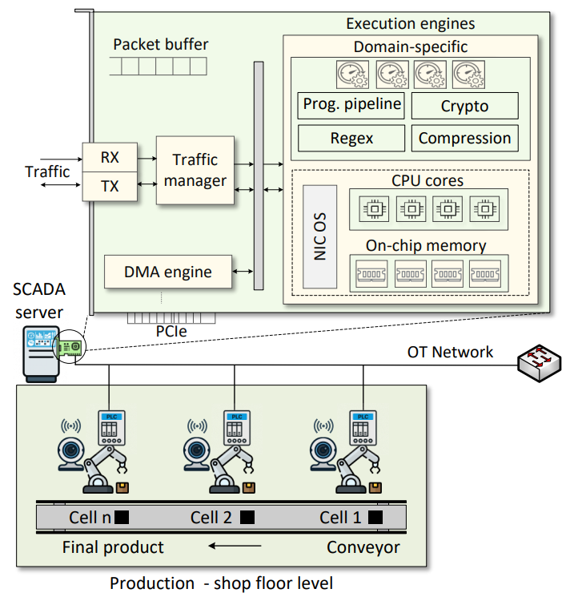
[FABRIC/KNIT12]
April 14-17, 2026
Current State
Cyber-physical systems (CPS) support critical infrastructure such as manufacturing and industrial automation.
Increasing IT/OT convergence exposes CPS networks to faults and cyberattacks and abnormal behavior in sensors, PLCs, or network traffic can disrupt processes.
Fast detection is essential to maintain system reliability and security.
Approach
The proposed system leverages SmartNICs and DPDK for high-speed packet processing.
A machine learning model is trained offline to detect abnormal behavior.
The trained model is offloaded to the SmartNIC for in-network inference.
The system enables detection of both faults and cyberattacks in the data plane.
Challenges
Cyber-physical systems require rapid detection of abnormal behavior, but traditional monitoring approaches rely on host-based processing that introduces latency and delays detection.
CPS environments generate high volumes of industrial network traffic and sensor data, making it difficult to perform real-time detection
Impact
The proposed system enables low-latency detection of CPS faults and cyberattacks while processing industrial network traffic directly in the data plane using SmartNIC acceleration.
FABRIC resources are used to design, deploy, and evaluate the experiments, leveraging SmartNICs that support DPDK.
Additional Information
Keywords: DPDK, SmartNIC, Cyber-Physical Systems, Attack Detection.

